Slide 1

SEN111 CSE111 Intro to Information and Communication Technology
Introduction
Lecture 1 (Week 1)
By Mr. Faheem Shaukat
faheem@iqraisb.edu.pk

Slide 2
Course Information
Pre Requisites
No
Text Book
Any Latest Edition
Computer Fundamentals Pardeep K. Sinha
C++ How to Program Dietel & Dietel
Notes:
We are not going to into the details of the semantics, we are only going to introduce the notions of different things in a programming language

Slide 3
Course Information
Course Web page http://github.com/faheemshaukat
Office Hours : Wednesday to Thursday
(12 PM to 02 PM)
TA: NIL
Lab Engineer: ME

Slide 4
Course Methodology
Lectures
Labs
Programming Assignments
Quizzes
Project
Presentation

Slide 5
Grading Policy (Tentative)
Final Exam (35 %)
Mid Term (20 %)
Quiz(s) (10 %)
Assignments (10 %)
Class Activity/Presentation (05 %) – Group
Lab Activities (20 %)

Slide 6
Collaboration Policy
Collaboration Policy
No collaboration allowed on assignments etc unless explicitly specified
A straight ‘0‘ in the case of collaboration
Any Question so far

Slide 7
Overview of Discussion
What is computer science?
What is a computer?
What can computers do?
How do computers solve problems?
Who invented computers?
Conceptual computers
Computing devices

Slide 8
Learning Objectives
Define and use terminology
Examples: computer science, Computer Programming, Software, Hardware, Algorithm, Flow Chart.
Distinguish between algorithms and non-algorithms
Know something about the history of computers (up to 1950)

Slide 9
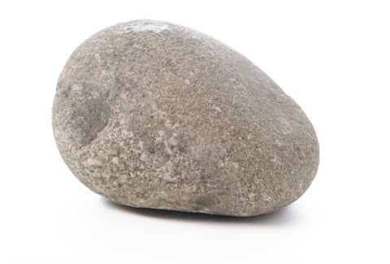
Which one is the computer?
Rock Calculator Television
Modern Airplane Washing Machine
Computer Workstation
Notes:
What devices and topics are the domain of computer science?

Slide 10
Is it a Computer?
What questions would you ask?
What experiments would you run?

Slide 11
Is a rock a computer?
Does not act or process
Takes no input and produces no output
Computers must be able to handle input and output

Slide 12
Is a washing machine a computer?
Input: dirty clothes
Output: clean clothes
Does not handle information
Computers input and output information

Slide 13
Is a television set a computer?
Input: information from cables or radio waves
Output: information as sound and picture
Does not process information
Computers process information by computing new results and answering queries

Slide 14
Is a modern airplane a computer?
Input: information from radio waves
Output: manipulations to the airplane
Can only handle specific information necessary for flight control
Computers are general purpose because they can perform many different tasks

Slide 15
Is an ordinary calculator a computer?
Input: numbers and mathematical operations
Output: answer
Handles any numeric task
Cannot remember which buttons are pressed
Computers are programmable so they can remember sequences of operations

Slide 16
Definition of a Computer
a general purpose,
programmable,
information processor
with input and output

Slide 17
Computing Agents
Definition of computers does not cover all that computer scientists study
Broader class of objects and methods – computing agents
Have some or all of the characteristics of a computer

Slide 18
Specialized Computing Devices and Information Appliances
Devices limited by set of operations or programmability
Calculators limited to operations described by their buttons
Global Positioning System (GPS) calculates latitude and longitude from satellite signals
Cell phone allows one to surf the web
Information appliances – performs a single job well
Notes:
Calculators become more powerful with each additional button

Slide 19
Embedded computers and robots
Machines with microcontrollers inside
Washing machines, airplanes, ATMs, etc.
Such machines require highly reliable, predictable computer programs
All physical mechanisms controlled by computers are robotic devices
Restrict definition to machines that are general purpose and programmable
Robotic arm or cart

Slide 20
What is a computer?
Definition of a computer is narrow
Definition of computing agent is broad
Although many computer scientists focus on the computer, some computer scientists deal with computing agents

Slide 21
What can computers do – today?
Business productivity managers
Personal information managers
Spreadsheets
Database software
Desktop publishing
Multimedia encyclopedias
Simulate the physical world
Produce a music video

Slide 22
What might computers do – tomorrow?
Diagnose diseases
MYCIN captures medical knowledge in rules that allowed a computer to identify an ailment based on symptoms
Control robots that walk, talk, and learn
CMU created a program that drove a van from Pittsburgh to D.C. using cameras for eyes
Compose music and create art

Slide 23
How do computers solve problems?
Humans deconstruct problems into small operations that a computer can carry out
Writing an algorithm
Solve a problem by computer requires
State the problem clearly in a problem statement
Solve the problem with an algorithm that gives clear instructions
Use a computing agent to carry out the instructions

Slide 24
Stating the problem clearly
Describes what to do, not how to do it
How do I get from Iqra campus to the Centaurus?
Solve general classes of problems
How do I get from point A in Iqra campus to point B?
What is the square root of y?

Slide 25
Specifying a problem
Clear problem statement is called the specification
What information can we use as input
What the output, or solution, to our problem should look like
Specification for the square root problem
Input: A positive number y > 0
Output: A positive number x such that x² = y
Make sure specification is not ambiguous

Slide 26
Solving the problem using an Algorithm
Algorithm – a clear sequence of instructions for performing a task
a well-ordered sequence
of well-defined,
feasible operations
that takes finite time to carry out
Notes:
Well-ordered – the algorithm clearly indicates in what order to perform the operations
Well-defined distinguishes the one action to take out of the many possibilities
Feasible – the step can be carried out by a realistic computing agent in reasonable time and effort

Slide 27
Almost Algorithms
To shampoo your hair
Rinse
Lather
Repeat
To set the time on the
Camera
Open the menu panel
Push the button to find time setting option
Set the hours, then the minutes
To write up about something
Get paper and pencil
Sit down
Do the Brainstorming
Write words on paper
Arrange phrases to make paras
If it sounds great, quit. Otherwise, go back to step 3.

Slide 28
Using the computing agent
The square root algorithm is only an algorithm for an agent that understands English and can perform arithmetic
Requirements imposed by the computing agent
Algorithm is in a language the computing agent understands
Algorithm uses primitive operations that the agent can carry out

Slide 29
Necessity of artificial languages
Problems with natural languages (like English)
Flexible
Often ambiguous
Computers use artificial languages with precise meanings
programming languages
Programming languages define primitive operations computing agents understand
Notes:
List operations that may not be feasible
Ambiguous not well-defined “Police Help Dog Bite Victim”
Examples of artificial languages – mathematical equations, music notation, programming languages

Slide 30
What is computer science?
The study of computers
The study of algorithmic processes including their
Theory
Analysis
Design
Efficiency
Implementation
Application
Notes:
Study how to make computers more like us - to have flexibility in their instructions that allows them to decide which action is best under certain circumstances
Study which problems have solutions that can be solved in a reasonable amount of time
Study the most efficient ways to solve problems
Study how to make information more secure
Study how to improve communication between computers
Study how to improve the quality of computer programs
Study how to improve programming languages
Study how to improve the interaction between people and computers
Study how to improve people’s access to information
Study how to improve the ability of computers to graphically model the world

Slide 31
Computer Programming
Why study Programming?
A very interesting field
If mathematics is the mother of all sciences
then
Computer Science is the facilitator of all sciences
Google became the number one company in employees’ satisfaction and the number one resource of Google are Computer Scientists

Slide 32

Interesting Applications of Computer Programming
Google – Search Engine
Every one seems to be using Google
Market Value of Google is more than $ 50 Billions
Larry & Sergey were at the number 14 in the list of richest persons of the United States in 2006
Notes:
Highlight that software should be resuable and robust and safe

Slide 33
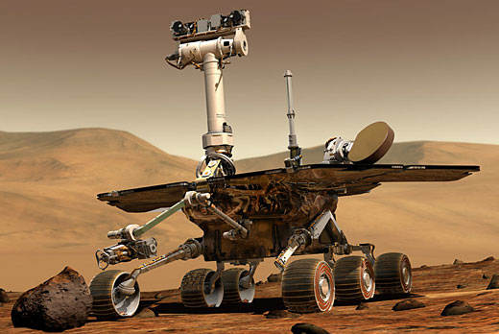
Interesting Applications of Computer Programming
Mars Path Finding mission
Mars Rover
Used in the
exploration of MARS
Uses software
Programs for
automatic
movement
Notes:
Software should be robust and reusable

Slide 34
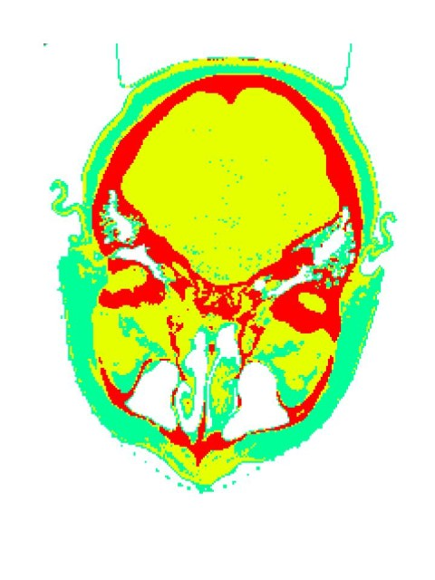
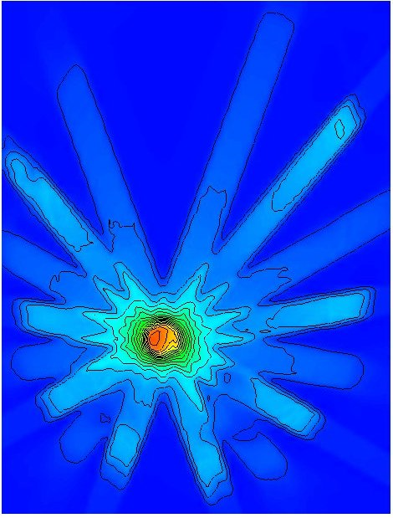
Interesting Applications of Computer Programming
Cancer Treatment
Acuros software developed in Los Alamos National Laboratory helps in
Precise modeling of patient’s anatomy
Precise focus and control of laser beams
Notes:
Softwares should be for good purpose ☺

Slide 35

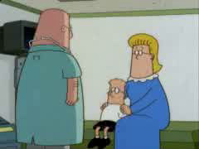
Interesting Applications of Computer Programming
Youtube – A Video Portal
Co-developed by Chad Hurley, Steve Chen and Jawed Karim
The most visited site in 2008
Acquired by Google in 2006 for USD 1.65 Billions
Notes:
Software should be Reusable, readable, scalable,

Slide 36

Interesting Applications of Computer Science
Facebook
Created by Mark Zuckerberg at the age of 19 when he was a student of Harvard University
In 2006, Microsoft purchased 1.6 % share of Facebook for $ 246 Million

